Slide 1
Project Presentation
CSE 104
1

Slide 2
2
Presented To :
MD Solaiman Mia
Assistant Professor
Presented By :
Shanjida Shochona
ID -- 213902093

Slide 3
Outline of the presentation
3
Introduction
Project Goal
Project Proposal Tools
Source Code
Output
Conclusion

Slide 4
Introduction :
4
Project Name – Digital Clock
At this time most peoples in the whole world use an automated digital clock in their everyday use. Starting from the hand watch we were to those huge street clocks every one of us are dependent on the display the make. In 21th century time being more than money, regarding this change our hobbies of checking our time every minute is dramatically increasing. About 99% of today’s digital clocks are made using microcontrollers which make them more hand able from the rest, those we can set the time to start any minute or second we want and also set an alarm for reminder so that the system will store the value in a memory and then when the time reaches the alarm will be on. As the microcontroller consists almost all the logical devices external logic gates doesn’t exist.

Slide 5
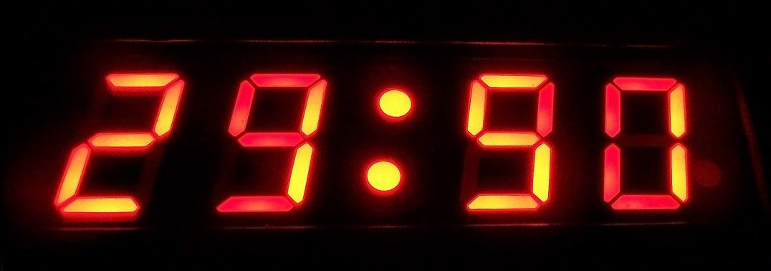
Project Goals
5
To build a digital clock successfully gaining all the required knowledge. To know about the working of each and every component and their role in the circuit. To apply our knowledge and understanding into practice. Clock display current time And it helps to maintain our daily life so that our goals is build a digital clock .
Initialize hour, minute, seconds with 0.
Run an infinite loop.
Increase second and check if it is equal to 60 then increase minute and reset second to 0.
Increase minute and check if it is equal to 60 then increase hour and reset minute to 0.
Increase hour and check if it is equal to 24 then reset hour to 0.

Slide 6
Project Proposal Tools
6
Code Blocks

Slide 7
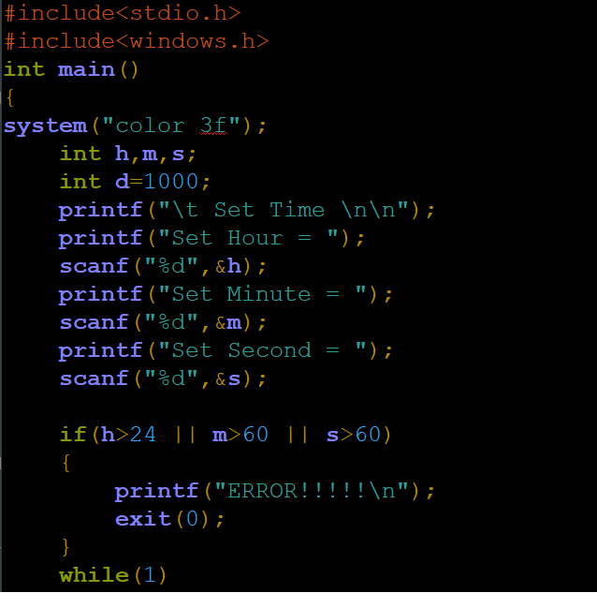
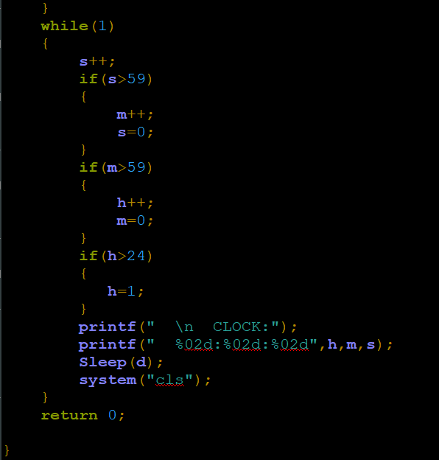
Source Code
7

Slide 8
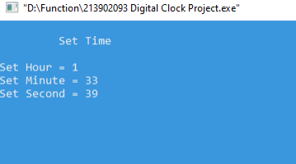
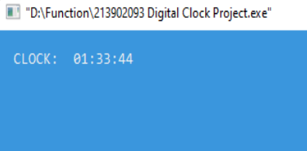
Out Put
8

Slide 9
Conclusion
9
We all are known “Time and tide wait for non” Time is very important for our daily life. So that we see time again and again. In our project we make a digital clock with using C programming . Thus, this is how our main system has been built up. More and more knowledge involving the whole system has been gained with time and through more research. We have completed this project successfully and have successfully made a 12hour digital clock with an alarm and a A.M./P.M. display.

Slide 10
10
THANK
YOU

